Slide 1
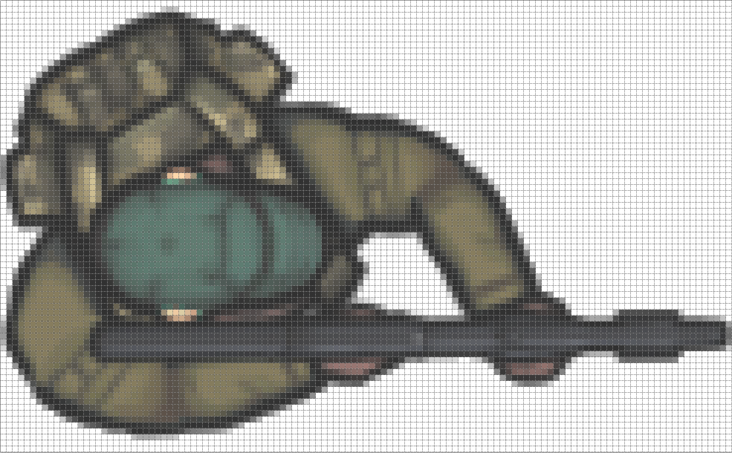
128
Center of Rotation
76
Gun Offset
Center
Offset
End of
Gun Barrel

